Slide 1

Intermediate SQL

Slide 2
Objectives
Group data into result sets.
Use string patterns and ranges in SQL queries.
Demonstrate how to use string patterns and ranges in SQL queries
Sort and order result sets.
Write sub-queries and nested select statements.
3.3 Intermediate SQL

Slide 3
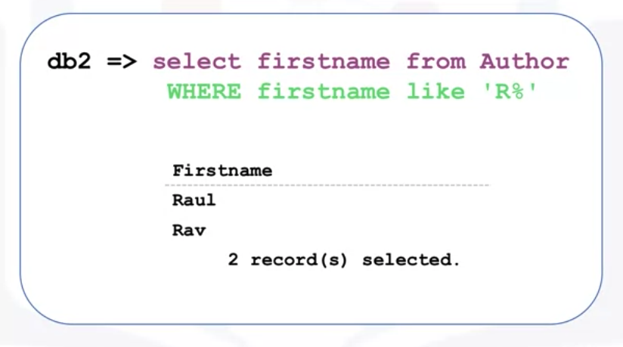
Using String Patterns and Ranges
Notes
Discuss
Using String Patterns and Ranges
Notes
Discuss
Using String Patterns and Ranges
WHERE
=
LIKE: %, _,
3.3 Intermediate SQL

Slide 4


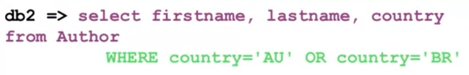
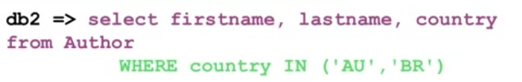
Using String Patterns and Ranges
Notes
Discuss
Using String Patterns and Ranges
Notes
Discuss
Using String Patterns and Ranges
WHERE
=, >, <
AND, OR
BETWEEN
IN
3.3 Intermediate SQL

Slide 5
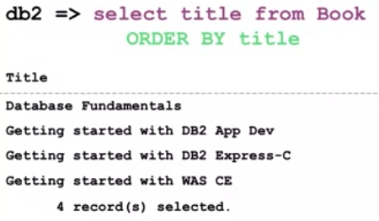
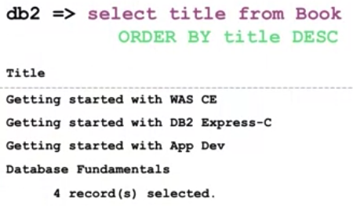
Sorting Result Sets
Using the ORDER BY clause( default the result set is sorted in ascending order)
3.3 Intermediate SQL

Slide 6
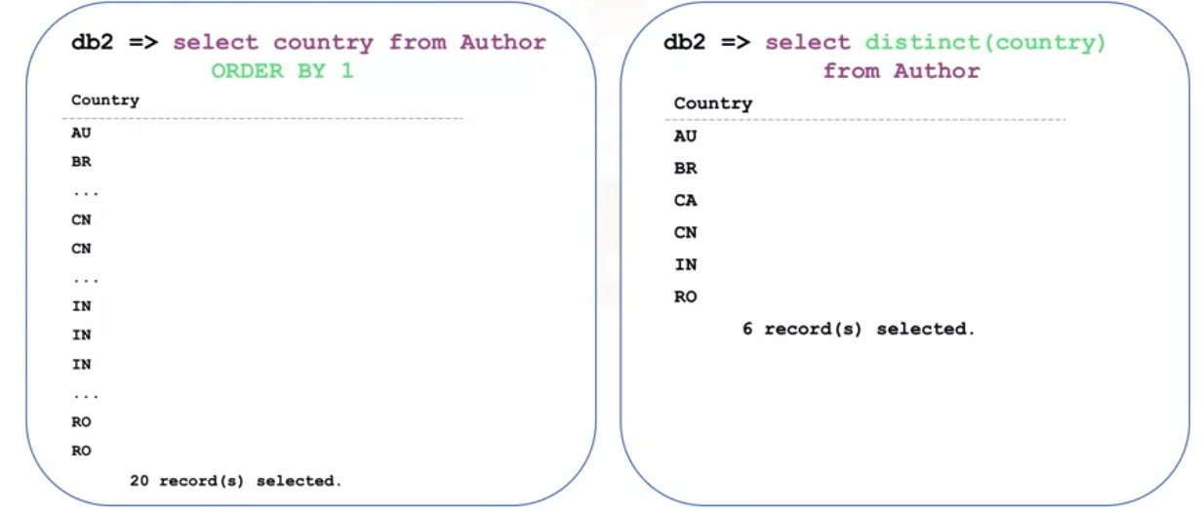
Eliminating Duplicate- DISTINT
3.3 Intermediate SQL

Slide 7
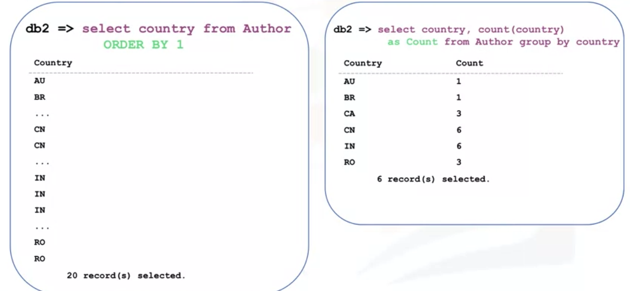
GROUP BY clause
3.3 Intermediate SQL

Slide 8
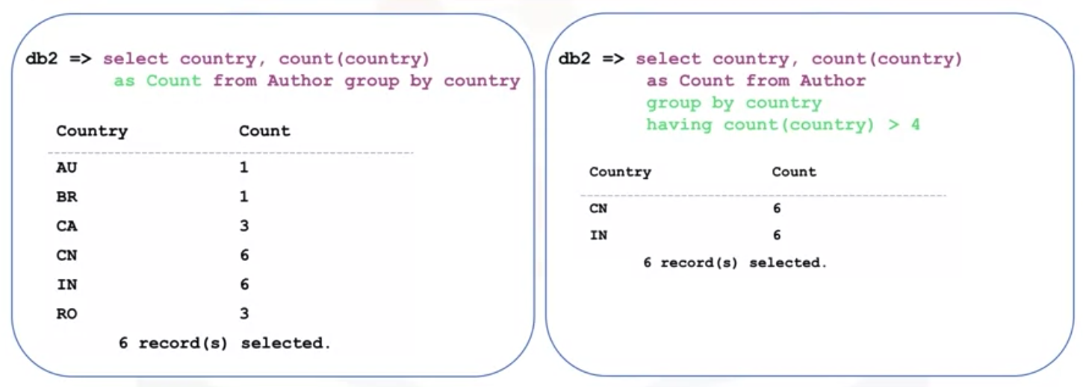
HAVING clause
Restricting the result set
3.3 Intermediate SQL

Slide 9
Built-in database functions
SUM: is used to add up all the values in a column. To use the function, you write the column name within parenthesis, after the function name.
MIN: return the minimum value
MAX: return the maximum value
AVG(): return the average value
ROUND(), LENGTH(), UCASE, LCASE
3.3 Intermediate SQL

Slide 10
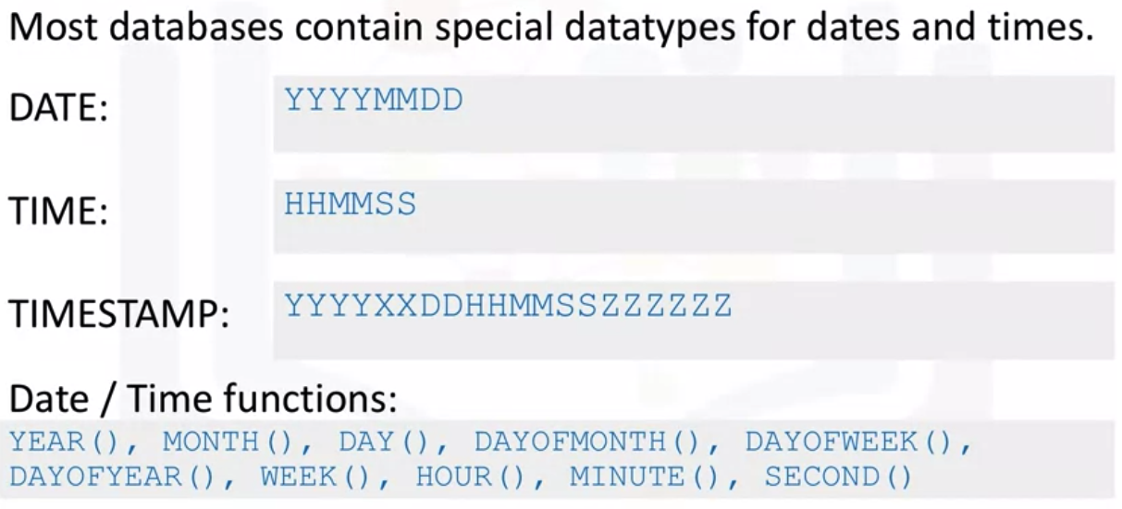
Data and Time
3.3 Intermediate SQL

Slide 11
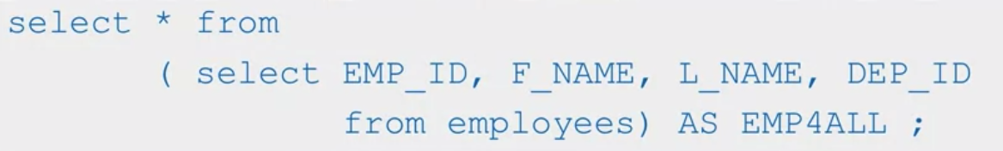
Sub- queries
Sub- query: a query inside another query
Sub- query in FORM clause: substitute the table name with sub-query. It is called Derived table
3.3 Intermediate SQL

Slide 12
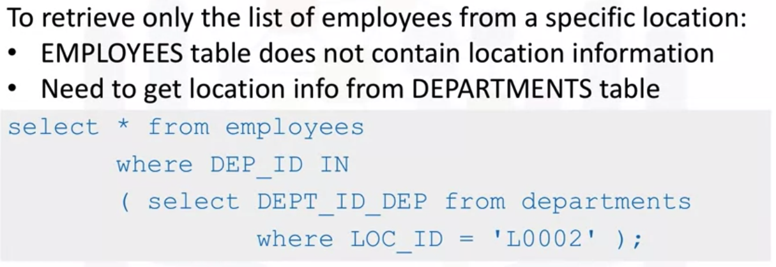
Multiple tables with Sub-queries
3.3 Intermediate SQL

Slide 13
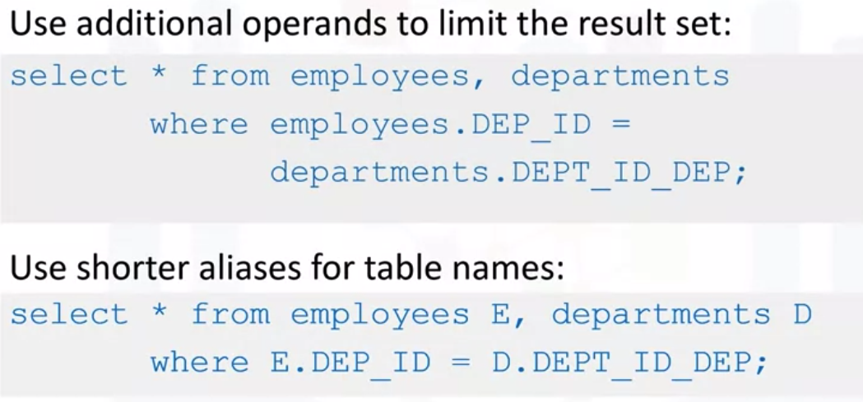
Multiple tables with implicit Join
3.3 Intermediate SQL

Slide 14
Summary
Group data into result sets.
Use string patterns and ranges in SQL queries.
Demonstrate how to use string patterns and ranges in SQL queries
Sort and order result sets.
Write sub-queries and nested select statements.
3.3 Intermediate SQL

Slide 15
Q & A
3.3 Intermediate SQL

